Slide 1
Personal Sensitivity and Conflict Resolution
ARES Leadership Conference
Plover, Wisconsin
November 6, 2004

Slide 2
Objectives
Understand Personal Sensitivity
Accept and Deal with Conflict
Overcoming Instinct
Creating a Mature, Healthy Environment

Slide 3
Personal Sensitivity
Walk in Another Person’s Shoes
Understand Their Challenges
Empathize
Being Sensitive is the Key!

Slide 4
Responses to Conflict
Avoid
Accommodate
Aggression/Engage
Compromise
*Collaborate

Slide 5
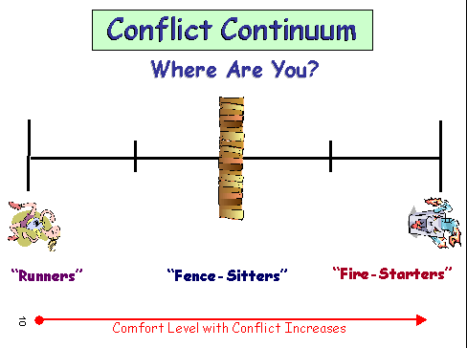

Slide 6
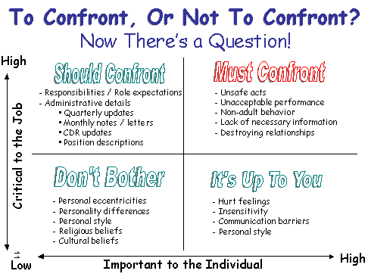

Slide 7
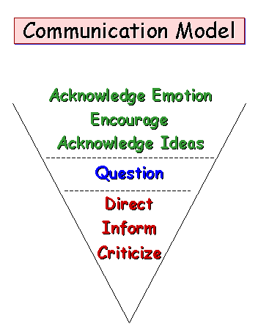

Slide 8
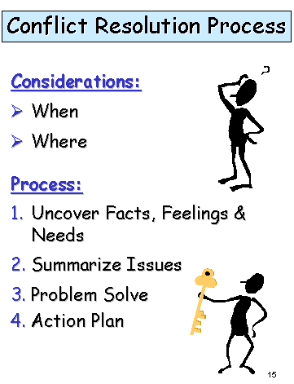

Slide 9
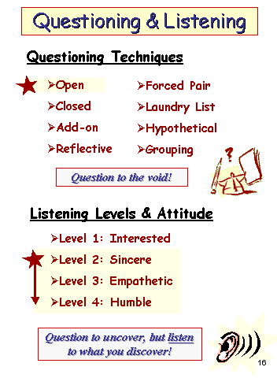

Slide 10
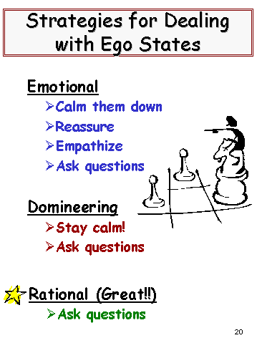

Slide 11
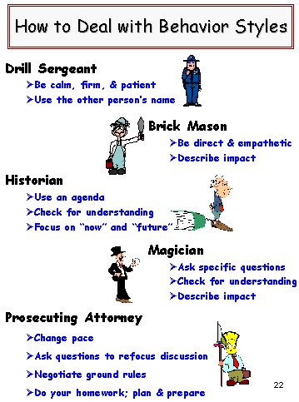

Slide 12
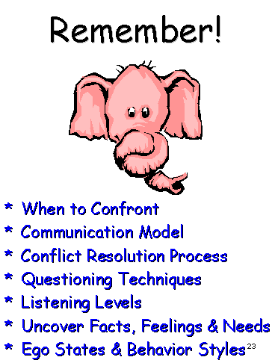

Slide 13
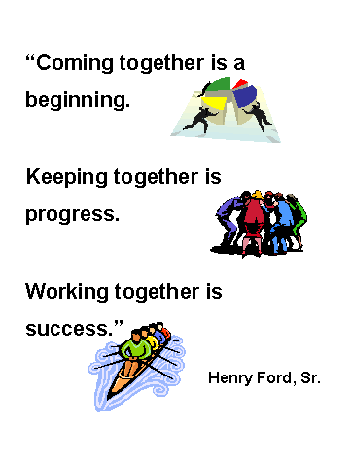

Slide 14
Sometimes even your best efforts will not work. At those times you need to cut your losses and move on. Don’t feel bad, just move on!

